Slide 1
Towards Knowledge Extraction from Weblogs and
Rule-based Semantic Querying
Xi Bai, Jigui Sun, Haiyan Che, Jin Wang
College of Computer Science and Technology
Jilin University
Email: xibai@email.jlu.edu.cn

Slide 2
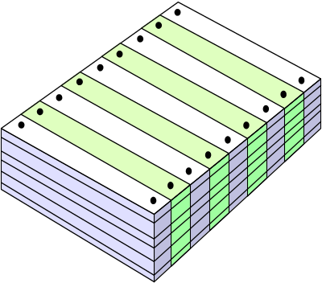
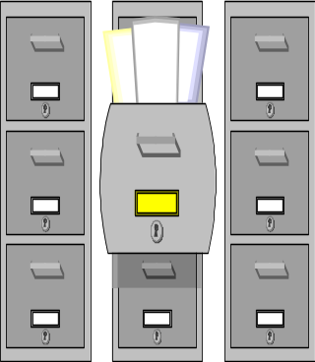
Towards Knowledge Extraction from Weblogs and Rule-based Semantic Querying

Slide 3
Towards Knowledge Extraction from Weblogs and Rule-based Semantic Querying
Goal:
  Propose a novel knowledge extraction framework for mining bolgs.
  Implement a prototype which can automatically extract the machine-understandable knowledge after the pre-clustering of blog pages.
Motivation:
  More and more companies and organizations begin to put their information on Web logs (blogs) nowadays.

Slide 4
Towards Knowledge Extraction from Weblogs and Rule-based Semantic Querying
  Since the data extracted by traditional IE techniques are usually not machine-understandable, it can not be processed by computers and remains raw and redundant
Challenge:
  How to crawl blog document efficiently
  How to extract the Information Content Blocks of Interests(ICBI)
  How to let the users take part in the reasoning

Slide 5
Overview
Background:
  Snippet clustering
  Web ontology languange (OWL)
  Reasoning
  Regular Expression
Experiments
  Extract information from the retrieved blogs without domain ontologies and with domain ontologies respectively

Slide 6
Overview
Related work
Future work
Conclusions

Slide 7
Snippet Clustering
Crawling
  Google AJAX Search APIs[1]
Features Extraction
  Vector Space Model (VSM)
  Suffix Array
    The suffix array of a string is the array of all its suffixes sorted by lexicographically
  [1] http://code.google.com/apis/ajaxsearch

Slide 8

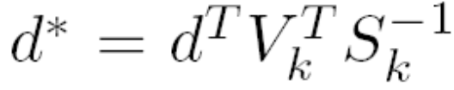
Snippet Clustering
Dimensions Reduction
  The dimension of feature vectors extracted from Chinese documents is usually too large (maybe larger than 50000)
  Latent Semantic Indexing (LSI)
  Singular Value Decomposition (SVD)

Slide 9
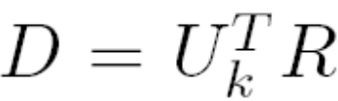

Snippet Clustering
Category-Names Extraction
  Cosine distance
Snippets Distribution
Interesting Block Extraction

Slide 10
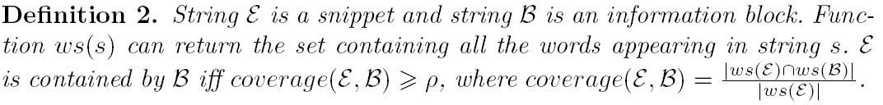
Snippet Clustering
Regular Expression
  “22-May-2007” “22 May 2007”
  (\d+)\.?-?\s?([\d\.\s-]+)\.?-?\s?(\d{4})

Slide 11
Knowledge Generation
K=(subject, predicate, object)
Word segmentation and Part of Speech tagging
  ICTCLSAS
Identify the subject, the predicate (core verb), and the object for each sentence
  ICTPROP

Slide 12
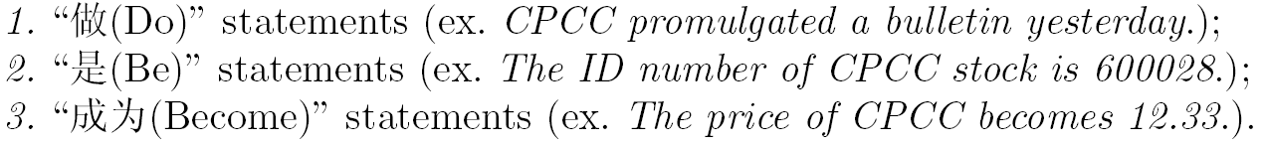
Knowledge Generation
Sentence Types:
Name Mapping
  Establish a Name Dictionary based on HowNet[2]
  [2] www.keenage.com

Slide 13
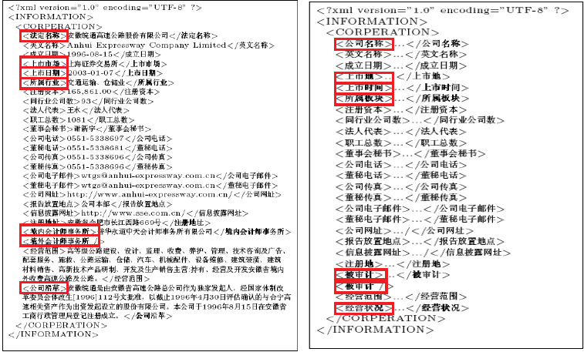
Example of Name Mapping

Slide 14
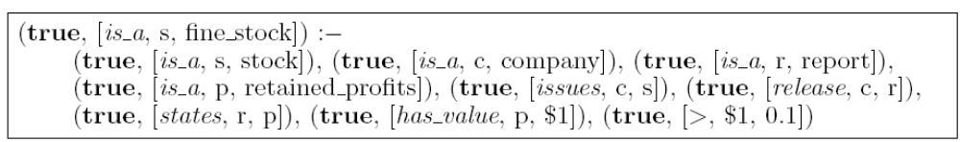
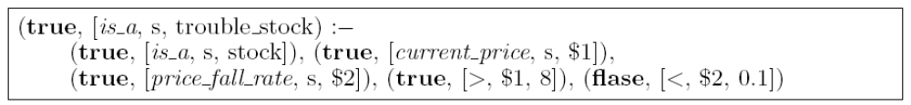
Rules Construction
Common Sense Rules:
Personalized Rules:
Knowledge Reasoning
  KAON2

Slide 15
Search and Results Presentation
We use the restrained NLP technique to deal with the users' queries. Restrained means users use text boxes to generate queries instead of using the natural language
Each query is composed of two sets:
  Condition set
  Variable set

Slide 16
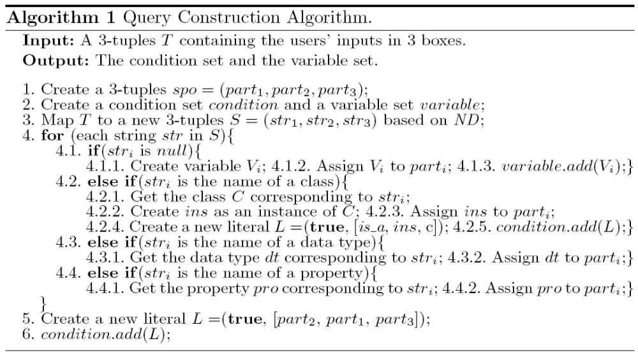
Query Construction Algorithm

Slide 17
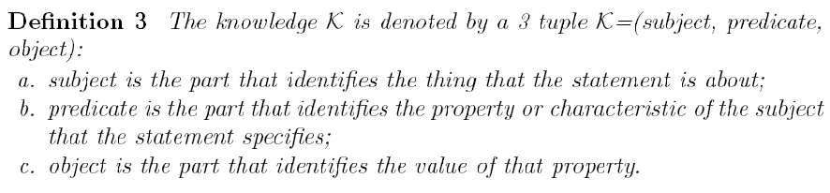
Knowledge Generation and Merging
Knowledge Generation
Based on Definition 3, extracting information from Web pages is actually a process of extracting subjects, predicates and objects

Slide 18
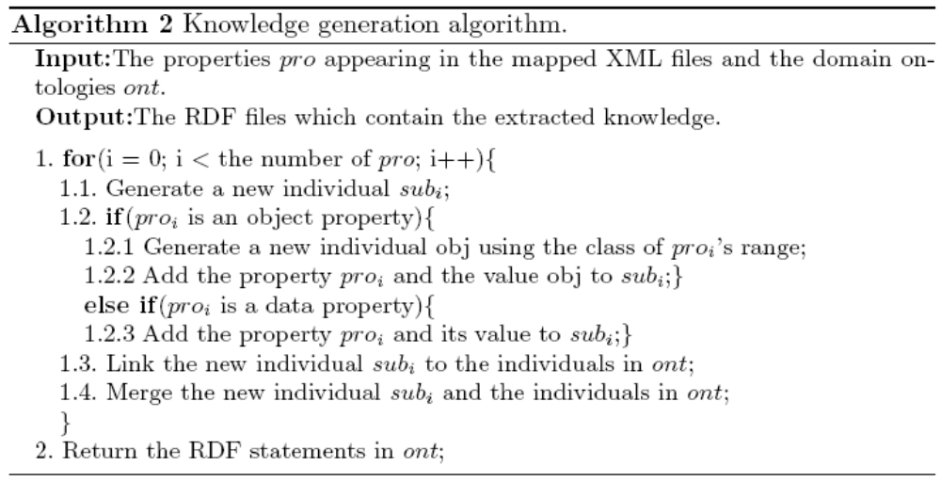
Knowledge Generation and Merging
Knowledge Generation

Slide 19
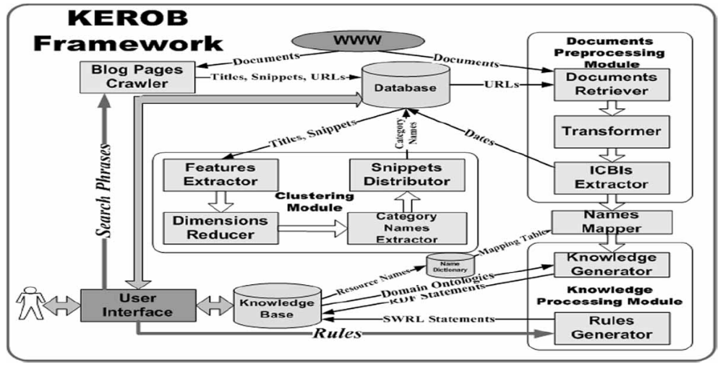
Framework for KEROB

Slide 20
Experiments
Environment
  AMD Athlon 64 CPU with 1.9GHz and 1GB of RAM
  Java programming language.
Data
  Retrieve 1509 blog documents by invoking Google AJAX Search APIs and taking stock as the inputted search phrase.
  Obtain 14 categories (total 1433 documents) except category other which contains the unclustered documents (total 76 documents)
  Ask 30 users to generate 600 queries for all this categories.

Slide 21

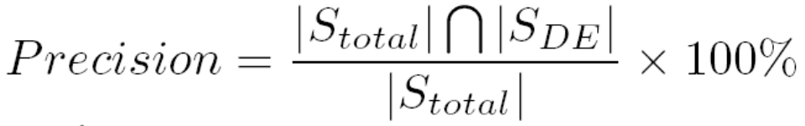
Experiments
We evaluate the performance of our approach by calculating Recall (R), Precision(P) and F-measure(F).

Slide 22
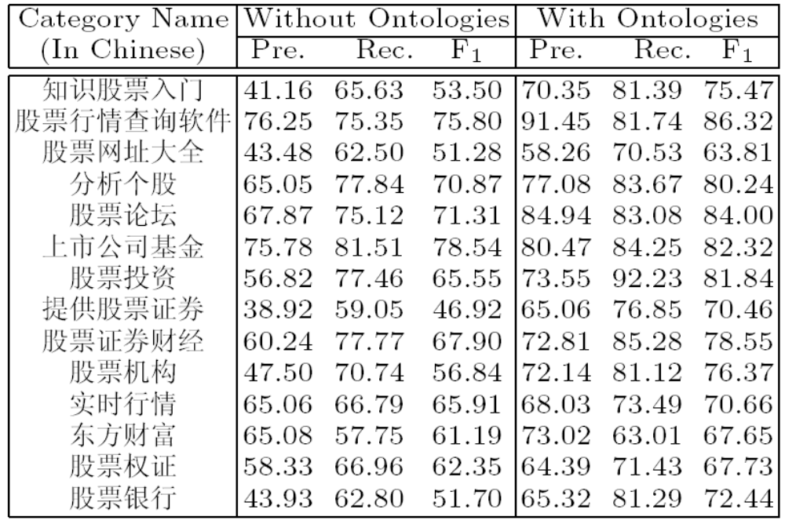
Performance

Slide 23
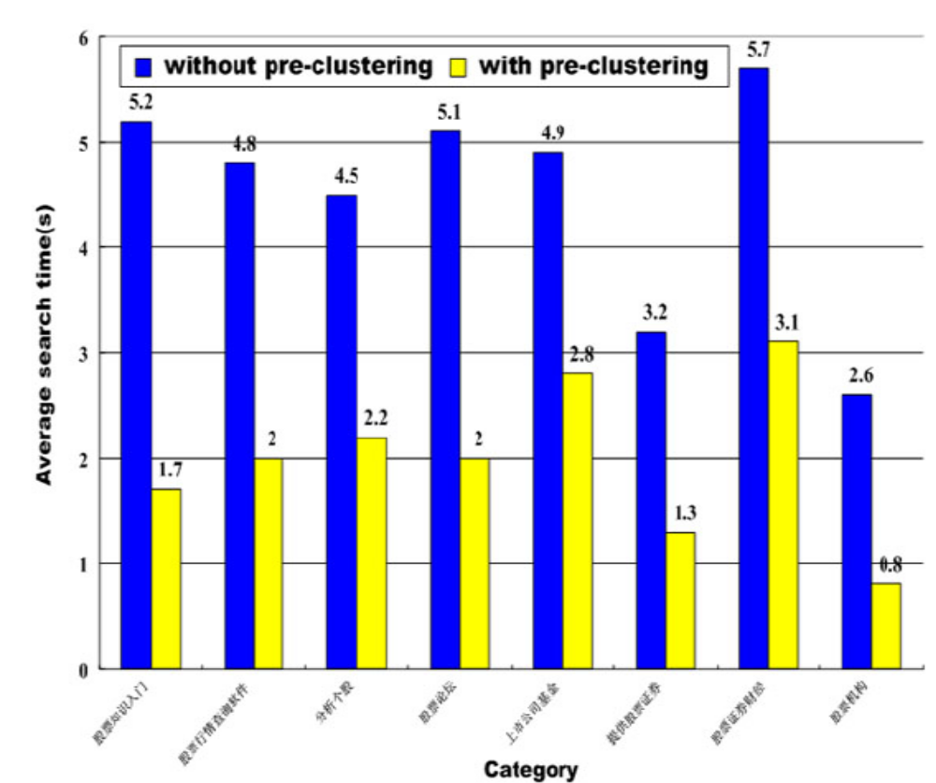
Search Time Comparison

Slide 24
Conclusions
Future Work
  Develop a more general knowledge search engine for blogs by importing other existing domain ontologies
Conclusion
  Our KB is timely updated in the background processing of KEROB. New rules can be created according to the users' specific needs. The experimental results indicate the superiority of our system

Slide 25
Thank you
&
Questions
xibai@email.jlu.edu.cn

